Slide 1


Economic & Fiscal Effects of Remote Work in FL
Client:
Florida Department of Economic opportunity

Slide 2
Economic Effects on FL Industries
Top 3
Change in Productivity (GDP)
% of employees working remotely
Bottom 3
Change in Productivity (GDP)
% of employees working remotely
Finance/Insurance, Scientific/Technical, Education
Agriculture, Accommodation/Food Service, Transportation/Warehouse

Slide 3
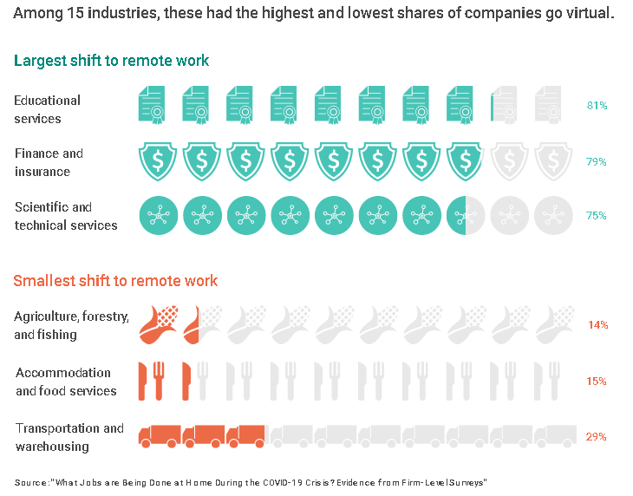

Slide 4
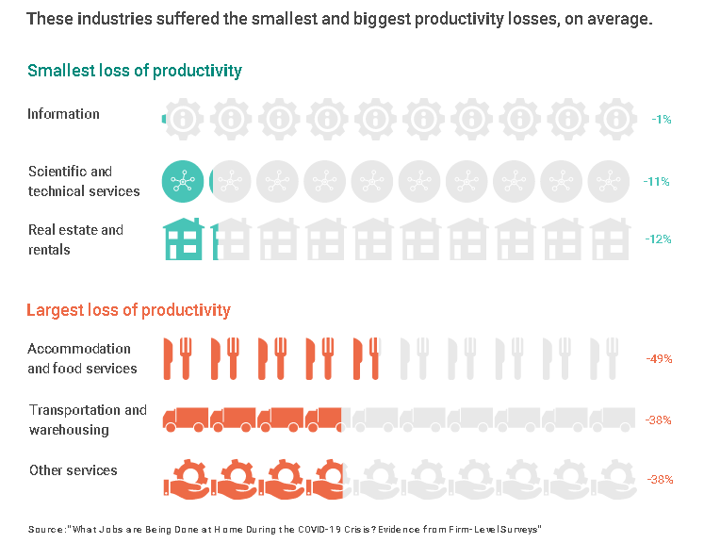

Slide 5
FL Industry Data Summary
Bureau of Labor Statistics | Federal Reserve Economic Data | Federal Reserve Economic Data
American Time Use Survey (ATUS) Average hours employed people spent working at home and at their workplace on days worked at these locations Percent of employed people who worked at home and at their workplace on days worked | Real Gross Domestic Product by Industry: Private Industries Construction for Florida (FLCONSTRQGSP) Private Industries for Florida (FLPIRQGSP) Information for Florida (FLINFORQGSP) Private services-providing industries for Florida (FLPRISERVPRORGSP) Real Estate and Rental and Leasing for Florida (FLRERENTLEARQGSP) | Real Gross Domestic Product by Industry: Private Industries Wholesale Trade for Florida (FLWHOLERQGSP) Retail Trade for Florida (FLRETAILRQGSP) Finance and Insurance for Florida (FLFININSRQGSP) Accommodation and Food Services for Florida (FLACCOMDRQGSP) Health Care and Social Assistance for Florida (FLHLTHSOCASSRQGSP)

